Slide 1


Progetto Pepper Sociale
Task: Object Detection

Slide 2
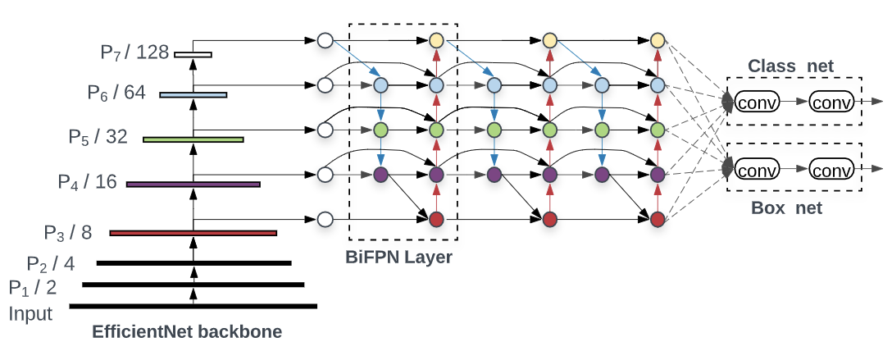
Design Choices:
Pre-trained Model: EfficientDet D1
Speed: 54 ms
Coco mAP: 38.4
Dataset used to train: COCO17
Number of classes: 90

Slide 3
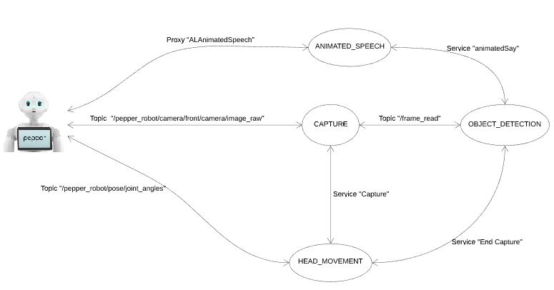
Architecture
Four nodes:
object_detection node for the detection task on images;
stream_capture node for the image acquisition;
head_movement node to manage the head coordinates;
animated_speech node that takes a string in input and let Pepper say it.

Slide 4
More details:
Topics:
For the acquisition of images from Pepper’s camera: /pepper_robot/camera/front/camera/image_raw
Services:
To publish image messages from stream_capture to object_detection node: /frame_read
To send head Pitch and Yaw coordinates to Pepper: /pepper_robot/pose/joint_angles
For capturing an image from the camera video: Capture
To communicate that the capture ended: capture_ended
To send a string to the animated_speech node: animatedSay

Slide 5
